Slide 1


2013 NRCS/IPM Workshop
Norm Leppla
UF, IFAS, IPM Program Director

Slide 2
2012 Workshop Topics
What is IPM?
National Roadmap for IPM
UF/IFAS and Related IPM Resources
IPM Practices in NRCS Programs
Access to IPM Information for Florida Crops
IPM Education, Training and Credentials
Goal: Increase IPM practices in NRCS conservation programs

Slide 3
2013 Workshop Topics
Importance of Insects
Principles of IPM
UF/IFAS and Related IPM Resources
UF/IFAS Diagnostic Laboratories
IPM Practices in NRCS Programs
Whole Farm IPM
Goal: Increase IPM practices in NRCS conservation programs

Slide 4
Why are Insects Important?
POLINATORS
PLANTS
SOIL
NUTRIENTS
HERBIVORES
CARNIVORES
DECOMPOSERS
Colunga-G

Slide 5
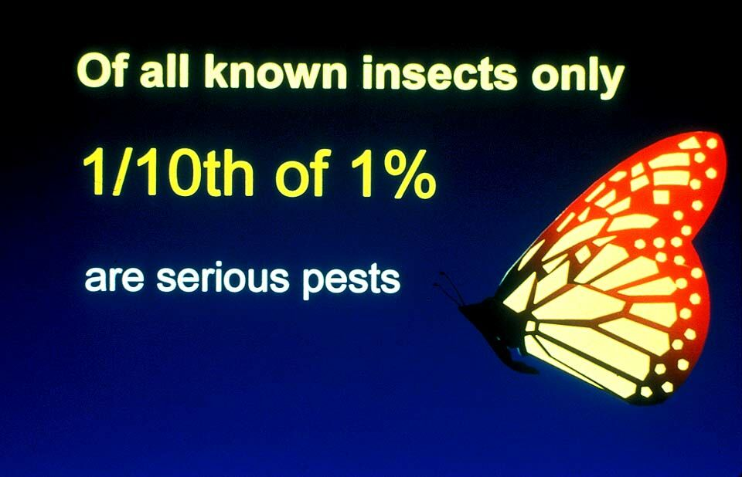
What Causes Pest Outbreaks?
Alien invasive species
Continuous monocultures
Disrupted environments
Pesticide resistance
Local invasions
Perceptions
Others causes?

Slide 6
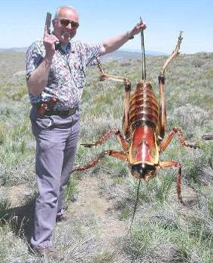
What is IPM?
It coordinates the use of pest biology, environmental information, and available technology to prevent unacceptable levels of pest damage by the most economical means, while posing the least possible risk to people, property, resources, and the environment.

Slide 7
IPM System
Pest outbreaks & disease epidemics
Environmental contamination
Human health hazards
Pest mgmt. costs
Reduce risks
INCREASE…
  Reliability
  Sustainability
Chem
Biological Control
Cultural Methods

Slide 8
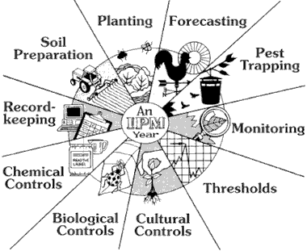
IPM Practices

Slide 9
Generic IPM Program
Biological knowledge
Monitoring and inspection
Act to control pests when necessary
Choose least-risk options
Long-term, preventative practices
Evaluation and records
Pesticide management
Continual improvement

Slide 10

IPM Florida provides statewide, interdisciplinary and inter-unit coordination and assistance for UF/IFAS integrated pest management research Extension and education faculty
http://ipm.ifas.ufl.edu

Slide 11
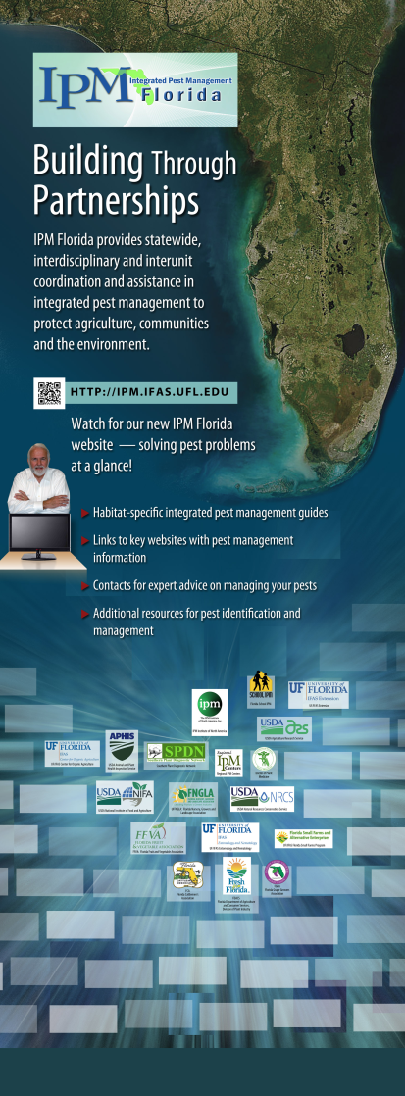
Direct Access to IPM Information
Habitat-specific IPM guides, fact sheets.
EDIS articles, Featured Creatures, etc.
Links to specialized websites with IPM
management information specific to
a crop or situation.
Key contacts for expert advice on
managing pests.
Additional resources for pest
identification and management,
e.g., diagnostic services.

Slide 12
Status of IPM for Florida Crops
Major Florida Crops | Approx. Acreage | IPM Programs Developed | Lead IFAS Faculty | IPM Florida Involved
Blueberry | 10,134 | X | Liburd
Citrus (orchards) | 576,577 | X | Rogers, Stansly | X
Cotton | 80,053 | Crop Profile | ?
Corn (grain) | 33,915 | ? | Nuessly
Corn (silage) | 27,005 | ? | Nuessly
Corn (sweet) | 29,000 | ?, PMSP | Nuessly
Grape | 300 | ? | Liburd | X
Melons | 25,000 | ?, PMSP | Webb
Organic | 5,974 | X | Swisher, Treadwell
Ornamental (woody) | 35,000 | X, PMSP | Buss, Mizell, Arthurs | X
Ornamental (GH & SH) | 40,000 | ? | Osborne, Mannion | X
Pasture (forage) | 354,860 | ? | ? | X
Pasture (hay) | 327,547 | ? | ?
Pecan | 8,652 | ? | Mizell
Peppers (Field) | 6,100 | X | Funderburk, Stansly | X
Peanut | 118,637 | Crop Profile | ?
Potato | 27,200 | ?, PMSP | ?
Rice | 11,376 | ? | ?
Snap bean | 12,400 | ? | ?
Soybean | 12,066 | ? | ?
Strawberry | 7,500 | X, PMSP | Liburd, Price | X
Sugarcane | 378,587 | ? | Cherry
Tomato (Field) | 35,000 | X | Funderburk, Stansly | X
Tropical fruit | 10,000 | ?, PMSP | Jorge Pena
Turf (Sod) | 100,000 | ? | Buss | X
Vegetables | 224,837 | X (PMSP) | Webb, Liburd, Stansly | X
Vegetables (GH) | 100 | X (some) | Osborne

Slide 13
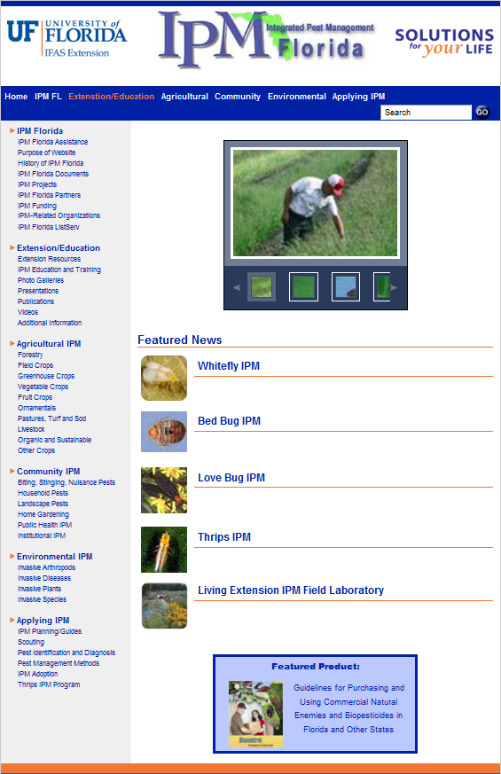
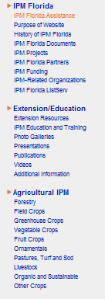
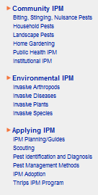

Slide 14

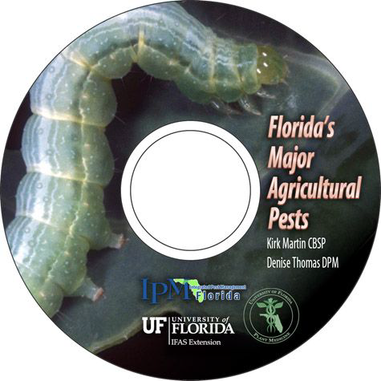
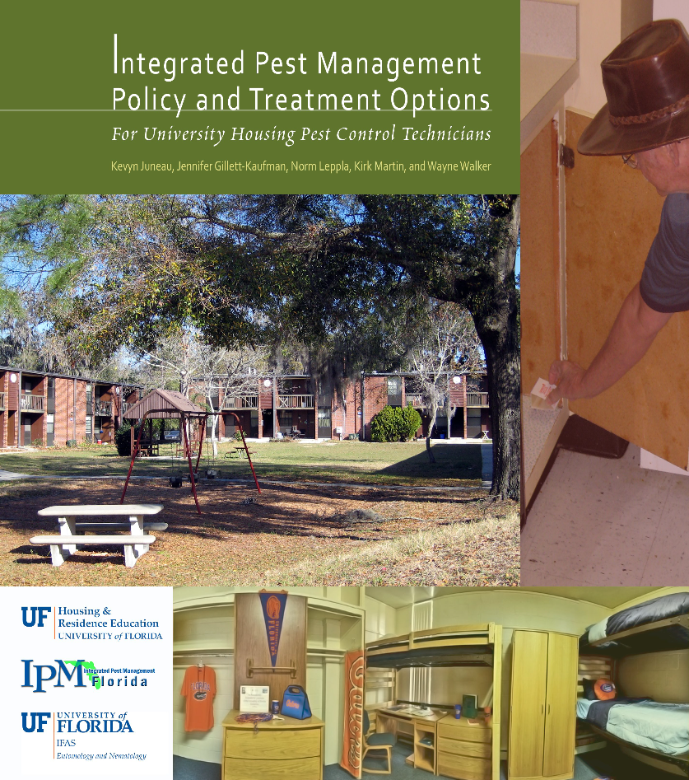
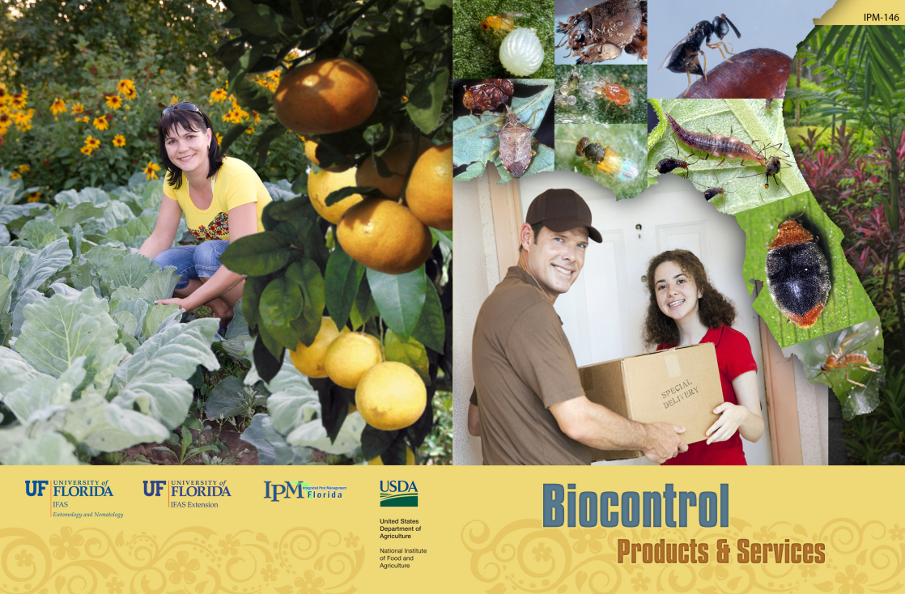
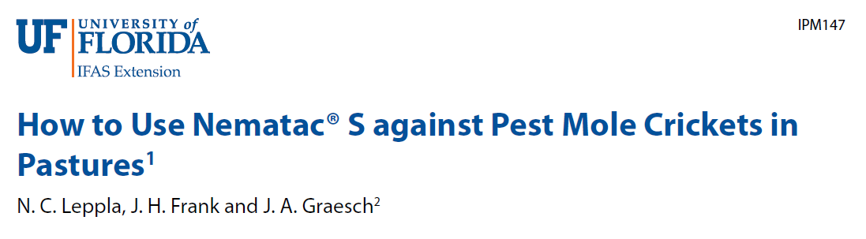
Extension Guides

Slide 15
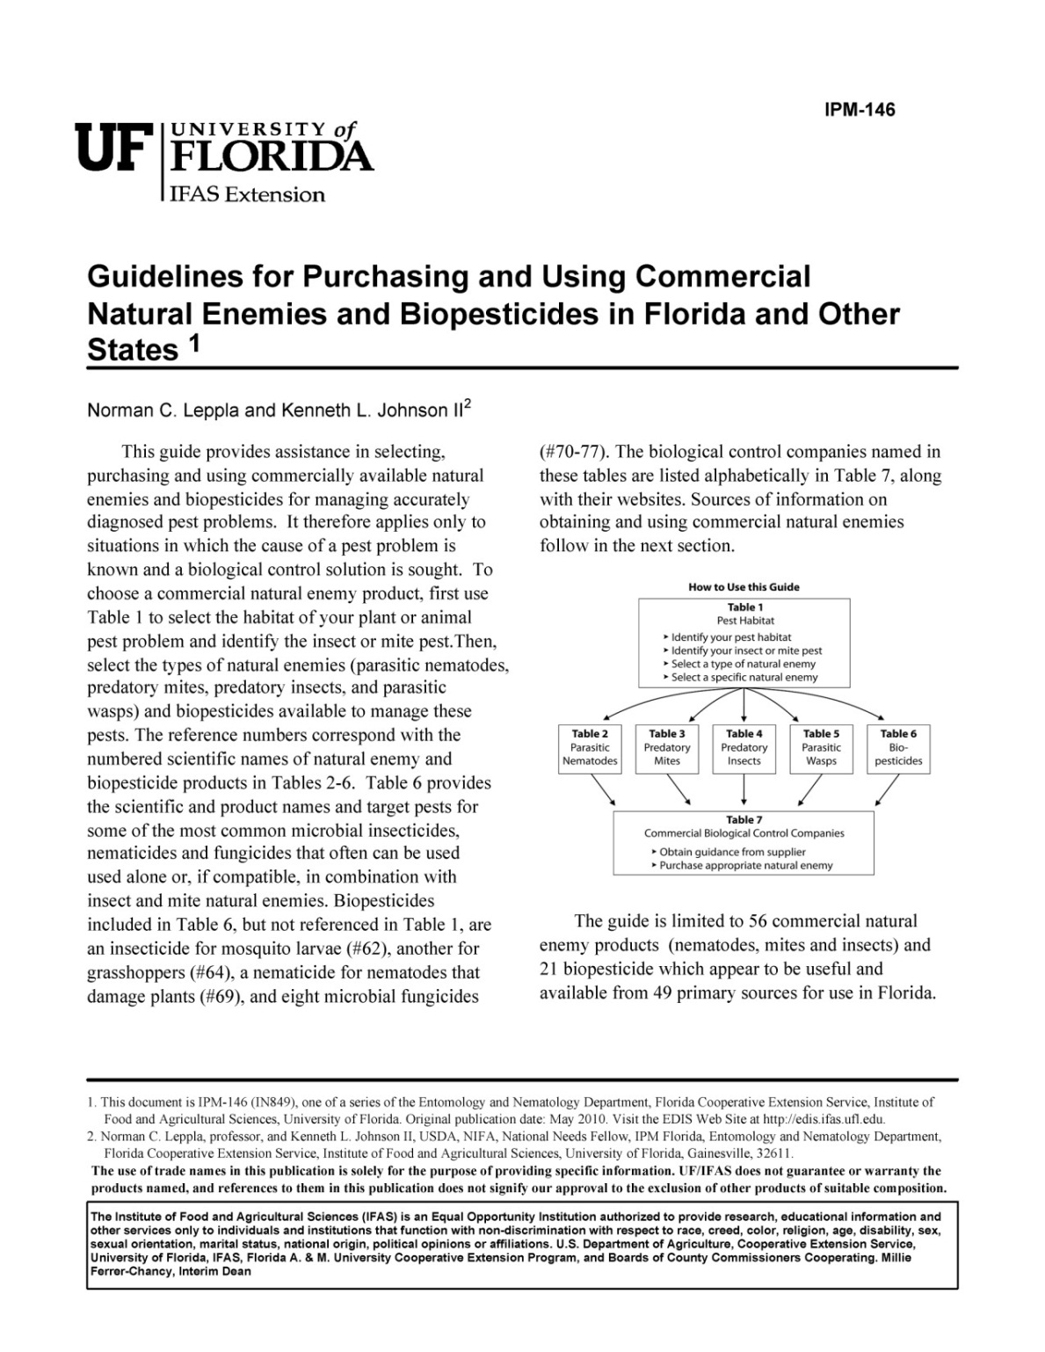

Slide 16
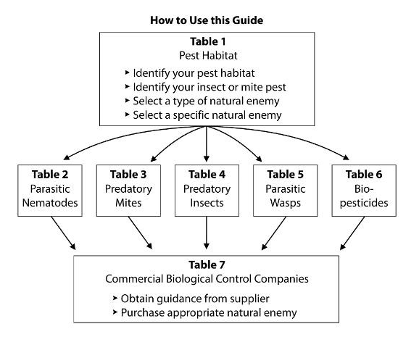

Slide 17
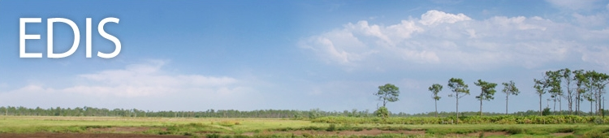
Electronic Data Information Source (EDIS)
The EDIS website is a comprehensive, single-source repository of all current UF/IFAS peer-reviewed publications (about 7,500).
http://edis.ifas.ufl.edu/

Slide 18
Electronic Data Information Source (EDIS)
Agriculture
Community Development
Environment
Families & Consumers
4H Youth development
Lawn & Garden
Aquaculture
Crops
Livestock
Nursery & GH
Organic farming
Agricultural safety
Small farms
Turf & sod

Slide 19






Featured Creatures provides in-depth profiles of insects, nematodes, arachnids and other organisms. The site is a cooperative venture of the University of Florida's Department of Entomology and Nematology and the Florida Department of Agriculture and Consumer Services' Division of Plant Industry. All articles are official publications of the University of Florida's Institute of Food and Agricultural Sciences.
 |  | or

Slide 20
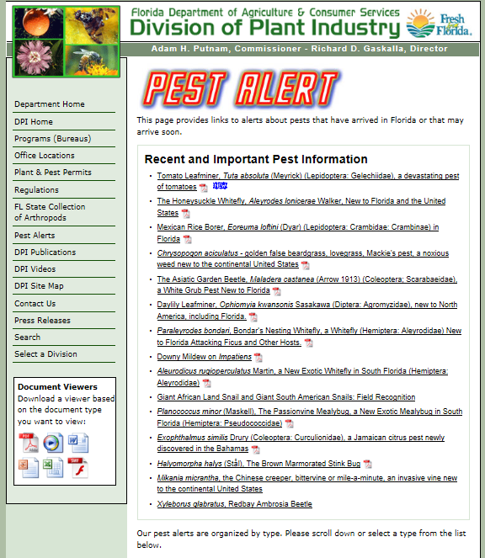

Slide 21
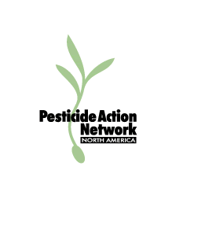
Pesticide Information
UF/IFAS Pesticide Information Office
CDMS- ChemSearch
CDMS- http://www.cdms.net/
LabelsMsds/LMDefault.aspx
EPA- http://www.epa.gov/
opp00001/regulating/
registering/data_sources.htm
Extension Pesticide Applicator Training

Slide 22
FDACS, DAES
Division of Agricultural Environmental Services, Bureau of Pesticides- Online Pesticide Registration System
Florida Pesticide Product Data
15,584 Products Registered
Select and Submit Option
Active Ingredient | EPA Registration Number
Site of Application | Product Name
Pest to be Controlled | Company Name
http://www.flpesticide.us

Slide 23
How to Send a Sample to Gainesville and Receive the Results?
Maybe if I put enough stuff in this box, put a stamp on it, and send it to Gainesville someone will tell me what’s wrong with my plant?
I can’t determine your problem here, but I can get your sample to the right laboratory for an accurate and timely diagnosis.

Slide 24
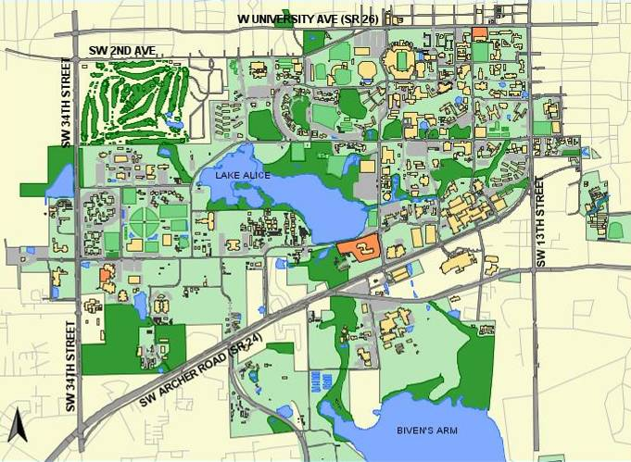
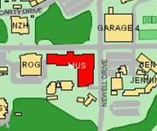
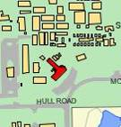
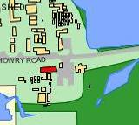
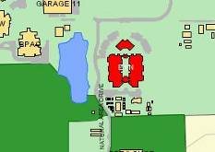
Plant Identification
Extension Soil Testing
Plant Disease Clinic & Nematode Assay
Insect Identification
A. Camerino

Slide 25
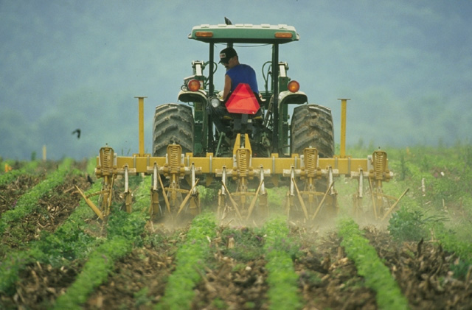
NRCS
CONSERVATION PRACTICE STANDARD
INTEGRATED PEST MANAGEMENT
(IPM) EQIP Code 595
DEFINITION
A site-specific combination
of pest prevention, pest avoidance, pest monitoring, and pest suppression strategies (PAMS).

Slide 26
PURPOSE
Off-site pesticide risks to water
Off-site pesticide risks to soil, water, air, plants, animals, and humans from drift and volatilization losses.
On-site pesticide risks to pollinators and other beneficial species through direct contact.
Cultural, mechanical, and biological pest suppression risks to soil, water, air, plants, animals, and humans.

Slide 27
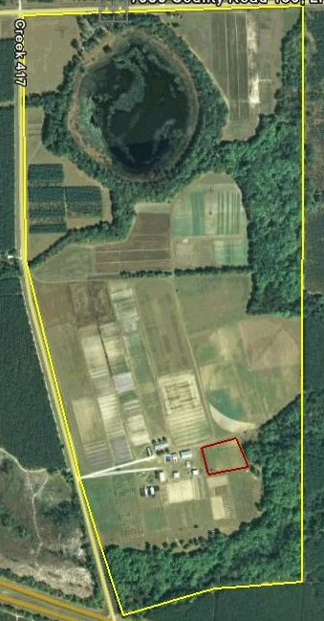
FY 2012 EQIP Practices that Affect Insects
Crop Rotation
Cover Crops
Field Border (Pollinator Habitat)
Forest Stand Improvement
Forage and Biomass Planting
Hedgerow Planting
Herbaceous Weed Management
Integrated Pest Management (595)
Residue Management
Strip Cropping
Wildlife Habitat
Windbreaks/Shelterbelt Management
Water Management
Nutrient Management
Pollinator Enhancement
Herbicide Resistance

Slide 28
Whole Farm IPM
Social Political
& Regulatory Environment
Crop Ecology
&
Management
Market
Farm Size, Labor, Capital Debt, Land
Efficiencies &
Cost of Production
Soil Health
Materials Containment
  Soil
  Residues
  Nutrients
  Pesticides
Physical
&
Biological Environment
Pest Management Above & Below Ground
Return
Landscape Ecology
R. R. Harwood

